Slide 1
Threading & MultiThreading
you have two main ways to create and work with threads: using the Thread class directly or implementing the Runnable interface. Here are the key differences between them:

Slide 2
A thread refers to the smallest unit of execution within a process. Generally, all the programs have at least one thread, known as the main thread, that is provided by the JVM or Java Virtual Machine at the starting of the program's execution.
In JAVA, you have two main ways to create and work with threads: using the Thread class directly or implementing the Runnable interface.
# Extends Thread
# Runnable Thread

Slide 3
Extending Thread:
When you extend the Thread class, your class becomes a thread itself.
The class directly inherits the methods provided by the Thread class, such as start(), run(), sleep(), interrupt(), etc.
This approach is useful when your class is specifically designed to be a thread and you don't need to extend any other class.

Slide 4
Example :

Slide 5
Runnable Thread:
When you implement the Runnable interface, your class can still extend other classes because Java allows multiple interface implementations.
The Runnable interface just defines a single method run() which your class must implement.
You then create an instance of Thread and pass your Runnable instance to its constructor.
This approach separates the task of the thread from the thread itself, promoting better design and code reusability.

Slide 6
Example:

Slide 7
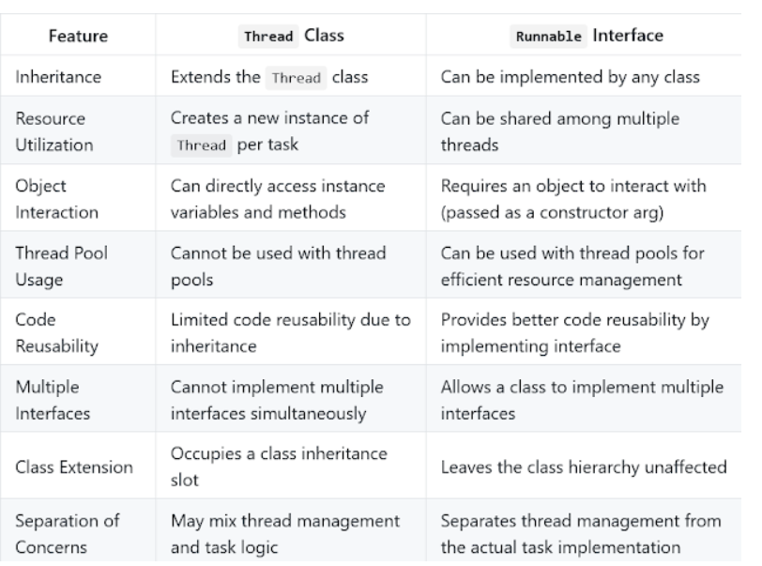
Difference b/w them:

Slide 8
Thread Priority:
The default priority is set to 5 as excepted.
Minimum priority is set to 1.
Maximum priority is set to 10.
// Set the priority of thread1 to maximum
thread1.setPriority(Thread.MAX_PRIORITY);
// Set the priority of thread2 to minimum
thread2.setPriority(Thread.MIN_PRIORITY);

Slide 9
Thread Methods:
Methods | Action Performed
isDaemon() | It checks whether the current thread is daemon or not
start() | It starts the execution of the thread
run() | It does the executable operations statements in the body of this method over a thread
sleep() | It is a static method that puts the thread to sleep for a certain time been passed as an argument to it
wait() | It sets the thread back in waiting state.
notify() | It gives out a notification to one thread that is in waiting state
notifyAll() | It gives out a notification to all the thread in the waiting state
setDaemon() | It set the current thread as Daemon thread
stop() | It is used to stop the execution of the thread
resume() | It is used to resume the suspended thread.

Slide 10
Thread Synchronization:
Synchronization in java is the capability to control the access of multiple threads to any shared resource.
In the Multithreading concept, multiple threads try to access the shared resources at a time to produce inconsistent results.
The synchronization is necessary for reliable communication between threads

Slide 11
Wait() & Notify():
wait() and notify() are methods provided by the Object class that enable inter-thread communication and synchronization.
They are used in scenarios where one thread needs to wait for a specific condition to be met before proceeding, and another thread needs to notify the waiting thread when that condition is satisfied.
The major difference is to wait to release the lock or monitor while sleep doesn't release any lock or monitor while waiting. Wait is used for inter-thread communication while sleep is used to introduce pause on execution

Slide 12
Lock & Condition:
The Condition interface represents a condition variable, which allows threads to wait until a certain condition becomes true.
It is conceptually similar to Object.wait() and Object.notify(), but it provides more control and flexibility.
A Condition instance is associated with a specific Lock, and threads must hold the associated lock before they can wait on or signal the condition.
Common implementations of the Condition interface are obtained from Lock instances, such as ReentrantLock.newCondition().

Slide 13
Deadlock:
Deadlock is a situation where multiple threads are waiting for each other to release resources causing cyclic dependency.

Slide 14
ThreadPool:
Java thread pool manages the pool of worker threads. It contains a queue that keeps tasks waiting to get executed.
We can use ThreadPoolExecutor to create thread pool in Java. Java thread pool manages the collection of Runnable threads.
The worker threads execute Runnable threads from the queue.

Slide 15
Timer Task:
Java Timer class is thread safe and multiple threads can share a single Timer object without need for external synchronization
Timer class uses java.util.TaskQueue to add tasks at given regular interval and at any time there can be only one thread running the TimerTask, for example if you are creating a Timer to run every 10 seconds but single thread execution takes 20 seconds, then Timer object will keep adding tasks to the queue and as soon as one thread is finished, it will notify the queue and another thread will start executing.
Java Timer class uses Object wait and notify methods to schedule the tasks

Slide 16
Interview Questions:
1. How do you ensure that the N thread can access N resources without deadlock ?
Ordering, if you acquire resources in a particular order and release resources in the reverse order you can prevent deadlock

